Slide 1

BAN 210 – FINAL ASSESSMENT BREAST CANCER DATA
BY-
NAME: POORNIMA SINGH
STUDENT ID: 125638213

Slide 2
OBJECTIVE OF THE ANALYSIS
What is the Classification of the Target Variable (Recurrence Event or Non- Recurrence Event)
Which model is performing better – Logistic Regression or Decision Tree

Slide 3
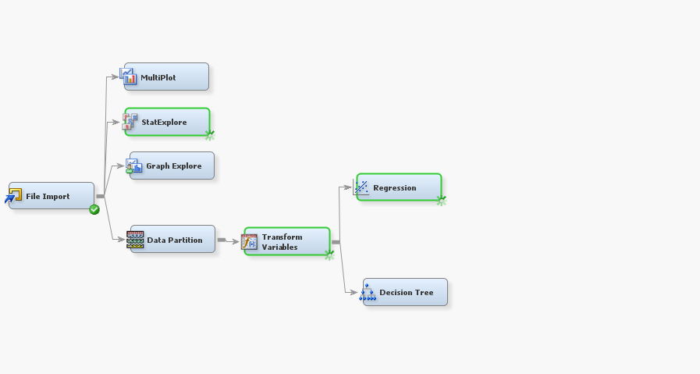
STEPS IN THE SAS DIAGRAM
The below steps/nodes have been used for the analysis:
Step 1: File Import
Step 2: Stat Explore
Step 3: Graph Explore
Step 4: Multiplot
Step 5: Data Partition
Step 6: Data Transformation
Step 7: Logistic Regression
Step 8: Decision Tree

Slide 4
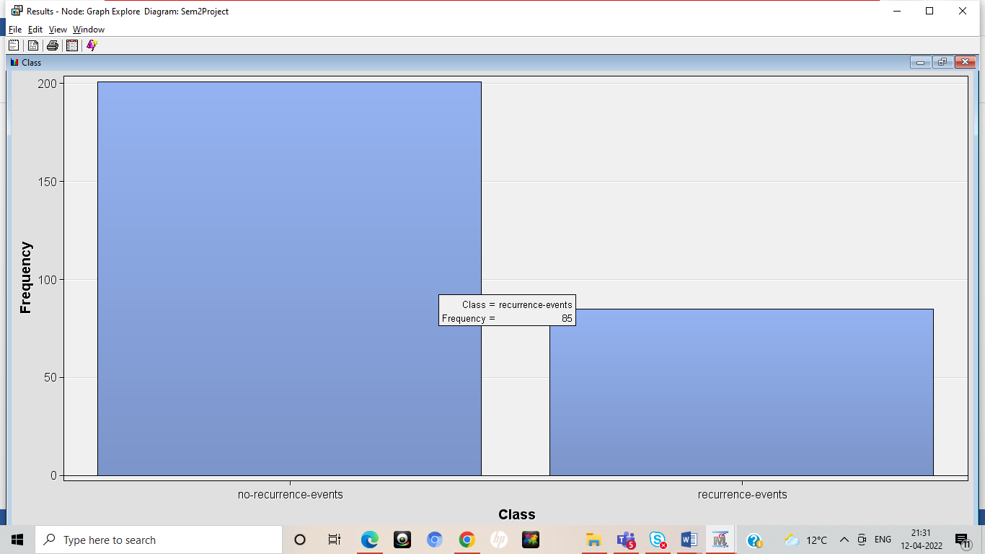
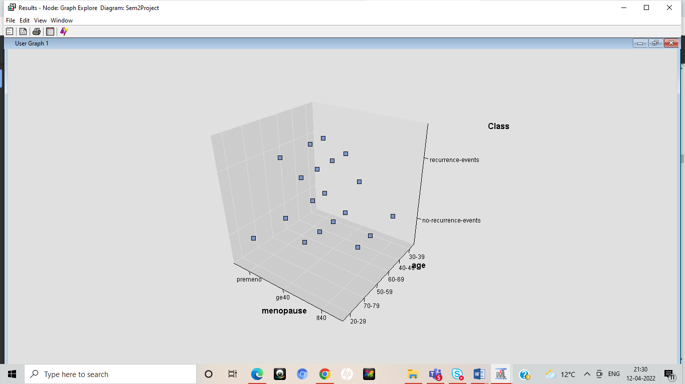
INSIGHTS ON TARGET VARIABLE
The frequency of Recurrence Event of Y is 86 and that of Non-Recurrence Event is 30
The Scatter Plot of 3 dimension is among Target Variable, Menopause and Age

Slide 5
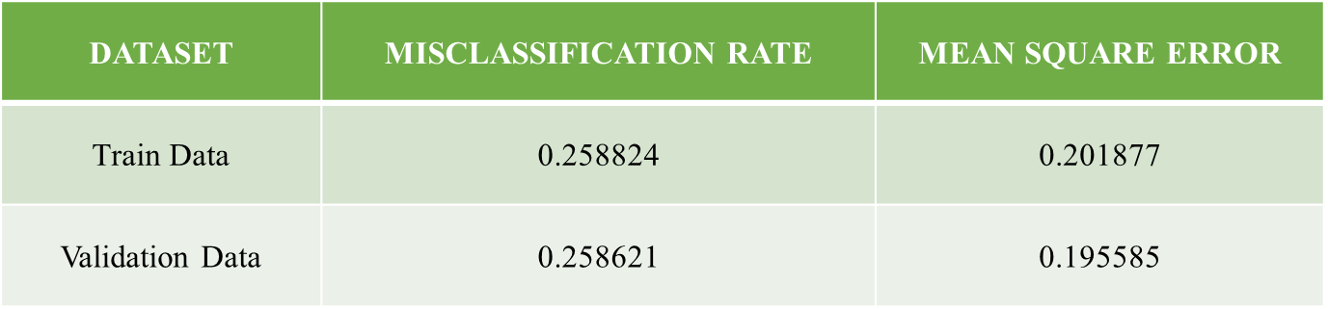
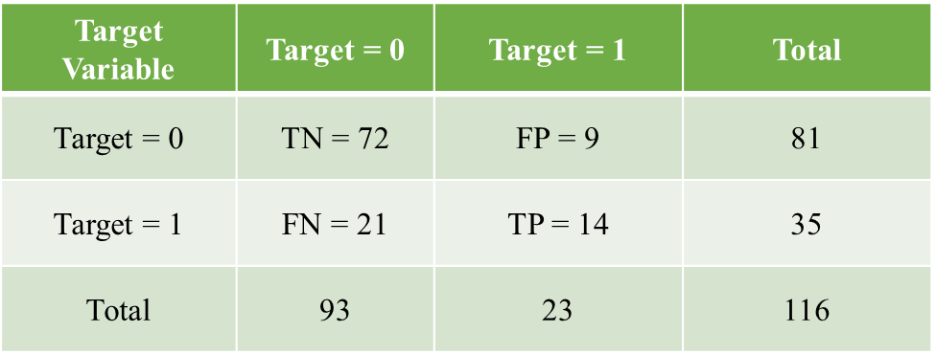
LOGISTIC REGRESSION MODEL
Recall = 0.4000
Precision = 0.6086
F1 = 0.4827

Slide 6

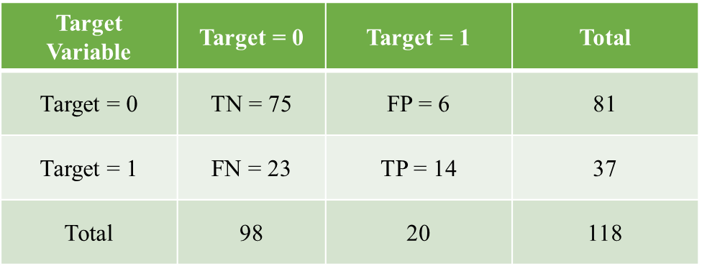
DECISION TREE MODEL
Recall = 0.6086
Precision = 0.7000
F1 = 0.6510

Slide 7
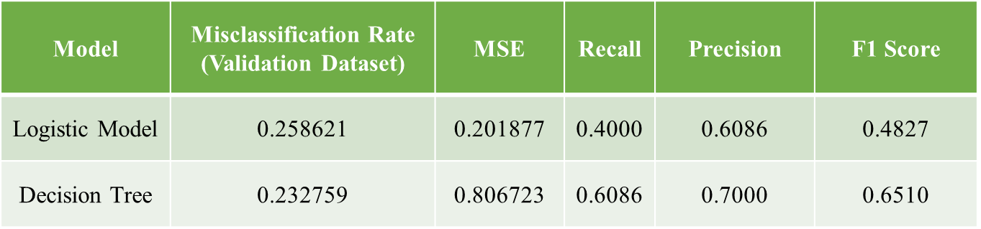
COMPARING MODELS
I compare the two models inferring MSE, Misclassification Rate, Recall, Precision and F1 Score. Decision Tree model is better than the Logistic Regression model, as the Precision and F1 Score is higher as compared to the Regression model

Slide 8
THANK YOU

